Slide 1
CT Liver Segmentation
LiTS benchmark data
Ansen

Slide 2
Data description
Liver Tumor Segmentation Benchmark (LiTS) organized in conjunction with the IEEE International Symposium on BiomedicalImaging (ISBI) 2017 and International Conference On Medical Image Computing & Computer Assisted Intervention (MICCAI) 2017.
In published benchmark, there are 130 cases for training and 70 cases for testing. (Testing ground truth is hard to find on internet.)
Data collected from 6 different CT scanners with different thickness. (0.7, 0.8, 1.0, 1.2, 1.5, 1.25, 2.0, 2.5, 3.0, 3.25, 4.0, 5.0 mm)
Data preprocess
In purpose of enhancing the data consistency, I selected different numbers of slices from each cases base on their thickness. Align all slices thickness into 5mm.
Flipping slices manually, since data with different orientation.
After above preprocessing, I selected slices with liver into our training/ validation/ testing set.
CT volume resize from (slices, 512, 512) into (slices, 256, 256).

Slide 3
Model architecture (3D-Unet)
https://arxiv.org/pdf/1606.06650.pdf
Pros
3D convolution takes before and after slices as reference to predict liver.
The depth of model can decide the number of reference slices.
Feature map concatenating fusion can compensate the lost information from down sampling.
Non-recursion computing.
Cons
Reference range of prediction is fixed after the architecture is decided.

Slide 4

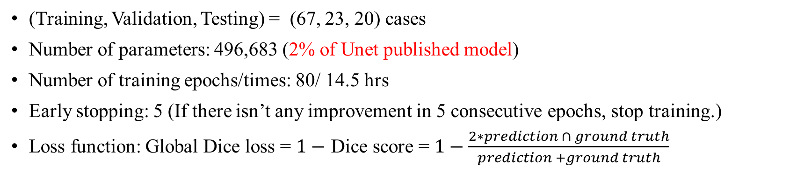
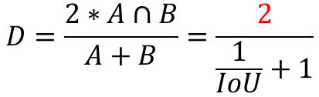

Training & Testing setting
(Training, Validation, Testing) = (67, 23, 20) cases
Number of parameters: 496,683 (2% of Unet published model)
Number of training epochs/times: 80/ 14.5 hrs
Early stopping: 5 (If there isn’t any improvement in 5 consecutive epochs, stop training.)
Loss function: Global Dice loss = $1−$ Dice score = $1−\frac{2∗prediction ∩ ground truth}{prediction +ground truth}$
Relation between Dice score and IoU
$$D=\frac{2∗A∩B}{A+B}$$
$$IoU=\frac{A∩B}{A∪B}$$
$$D=\frac{2∗A∩B}{A+B}=\frac{2}{\frac{1}{IoU}+1}$$

Slide 5
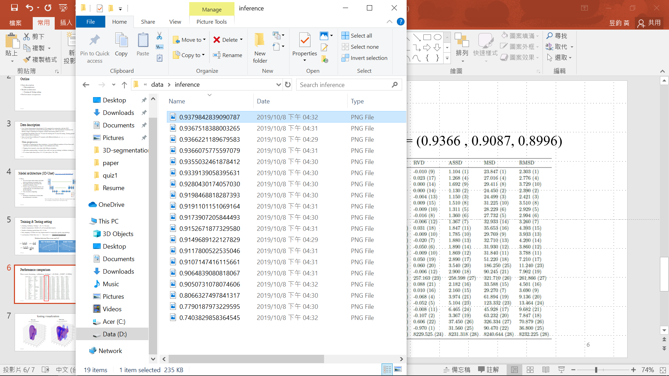
Performance comparison
Dice score (training, validation, testing) = (0.9366 , 0.9087, 0.8996)
All test cases Dice score

Slide 6
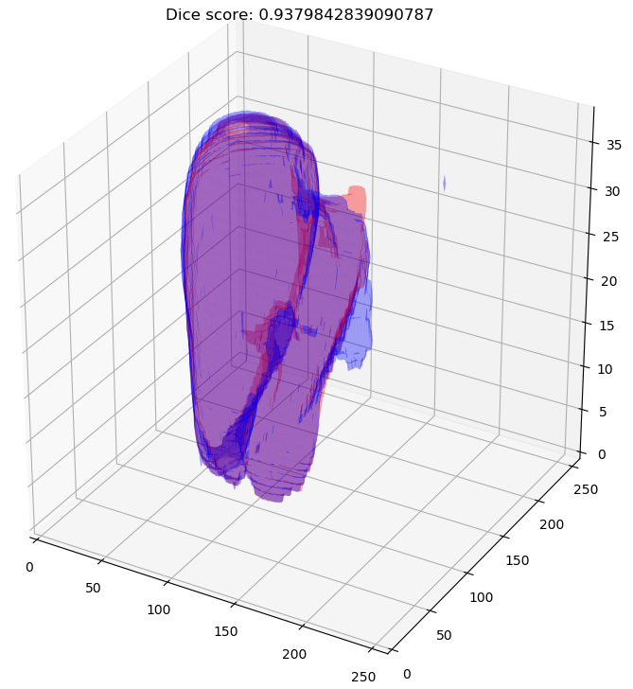
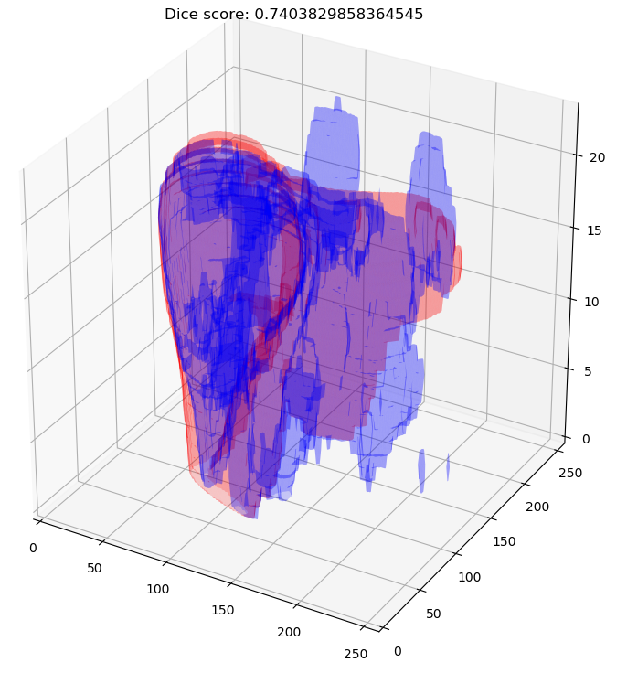
Testing visualization
Red: Ground truth
Blue: Prediction
Best case
Worst case

Slide 7
CT Liver Segmentation U-net Version 2
New cases from NTUH
Ansen

Slide 8
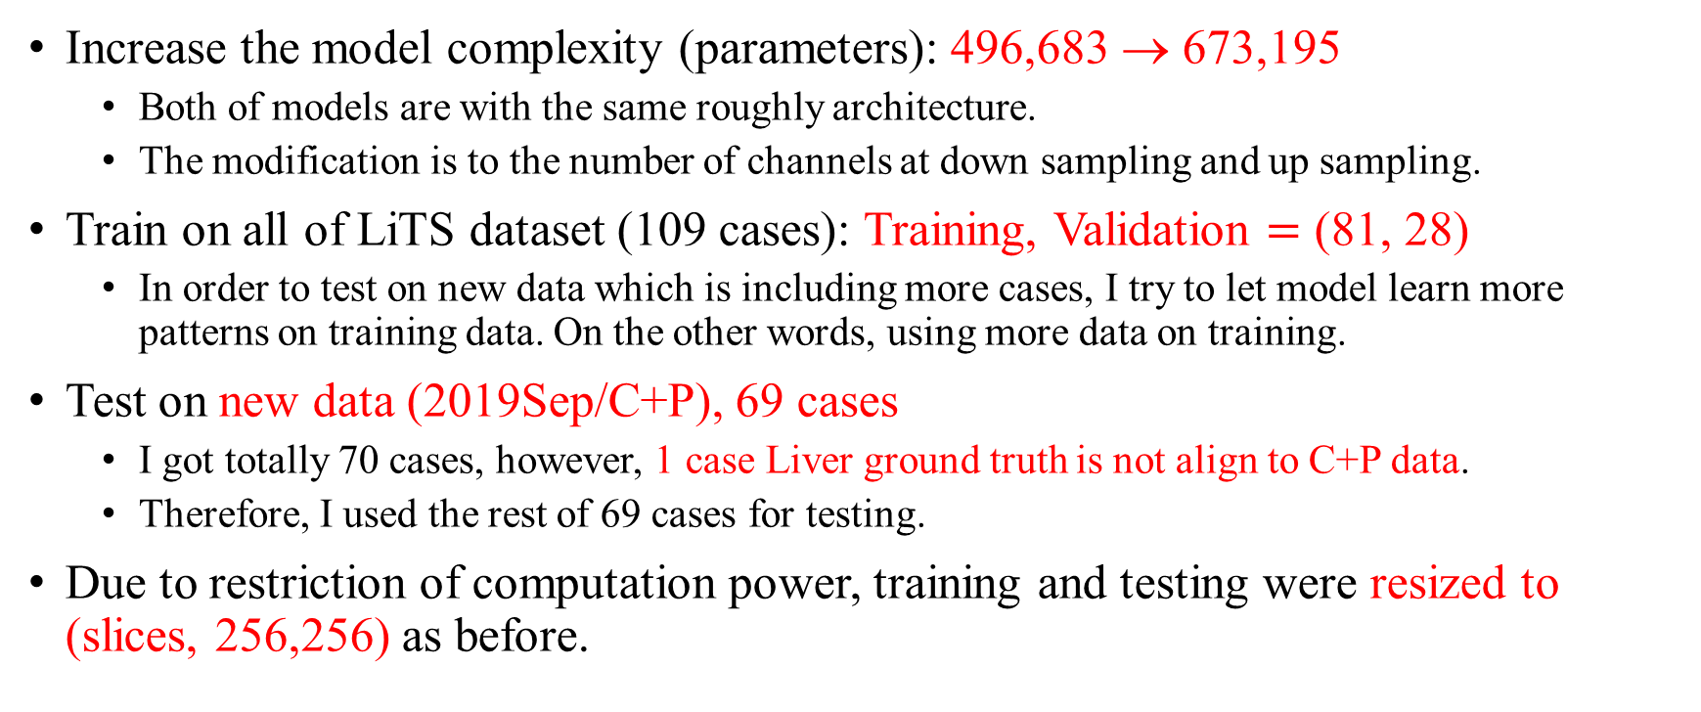
Do some modification to model …
Increase the model complexity (parameters): 496,683 → 673,195
Both of models are with the same roughly architecture.
The modification is to the number of channels at down sampling and up sampling.
Train on all of LiTS dataset (109 cases): Training, Validation $=$ (81, 28)
In order to test on new data which is including more cases, I try to let model learn more patterns on training data. On the other words, using more data on training.
Test on new data (2019Sep/C+P), 69 cases
I got totally 70 cases, however, 1 case Liver ground truth is not align to C+P data.
Therefore, I used the rest of 69 cases for testing.
Due to restriction of computation power, training and testing were resized to (slices, 256,256) as before.

Slide 9
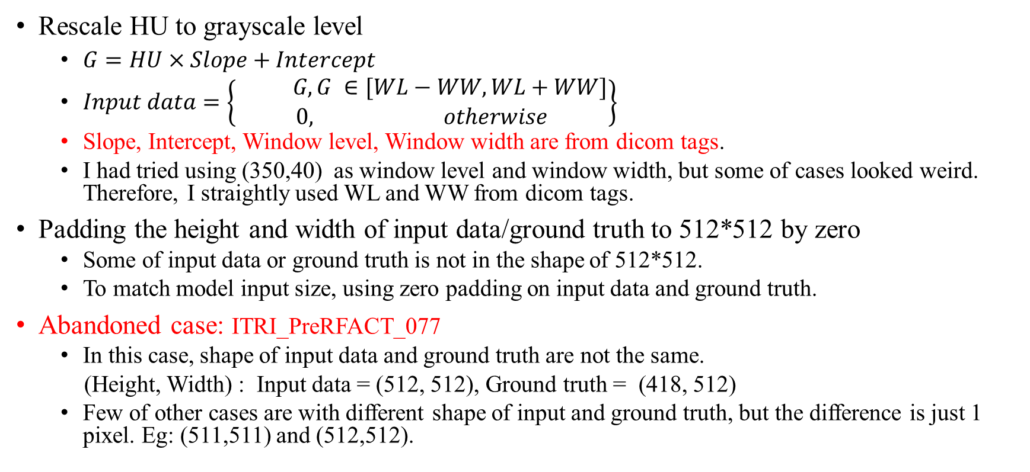
New cases preprocessing
Rescale HU to grayscale level
$G=HU×Slope+Intercept$
$Input data=\left\{\begin{aligned} G, G ∈[WL−WW,WL+WW] \\ 0, otherwise\end{aligned}\right\}$
Slope, Intercept, Window level, Window width are from dicom tags.
I had tried using (350,40) as window level and window width, but some of cases looked weird. Therefore, I straightly used WL and WW from dicom tags.
Padding the height and width of input data/ground truth to 512*512 by zero
Some of input data or ground truth is not in the shape of 512*512.
To match model input size, using zero padding on input data and ground truth.
Abandoned case: ITRI_PreRFACT_077
In this case, shape of input data and ground truth are not the same.
(Height, Width) : Input data = (512, 512), Ground truth = (418, 512)
Few of other cases are with different shape of input and ground truth, but the difference is just 1 pixel. Eg: (511,511) and (512,512).

Slide 10
Performance comparison
Model | Parameters | (Train, Val, Test) setting | Training set source | Testing set source | Training set dice score | Validation dice score | Testing dice score
Unet_v1 | 496,683 | (67, 23, 20) | LiTS | LiTS | 0.9366 | 0.9087 | 0.8996
Unet_v2 | 673,195 | (81, 28, 69) | LiTS | NTUH | 0.9443 | 0.9203 | 0.9219
Testing result analyzation
Model | update times | Best test cases | Worst cases | Q1 (25%) | Q2 (Median) | Q3 (75%) | IQR (Q3-Q1) | Mean | Std
Unet_v1 | 74*67= 4958 | 0.9380 | 0.7403 | 0.9064 | 0.9173 | 0.9355 | 0.0291 | 0.8996 | 0.0558
Unet_v2 | 14*81= 1134 | 0.9640 | 0.7137 | 0.9144 | 0.9328 | 0.9460 | 0.0316 | 0.9219 | 0.0419

Slide 11
Performance comparison (training, validation, testing)
Unet_v1 : (0.9366 , 0.9087, 0.8996), Unet_v2 : (0.9443 , 0.9203, 0.9219)

Slide 12
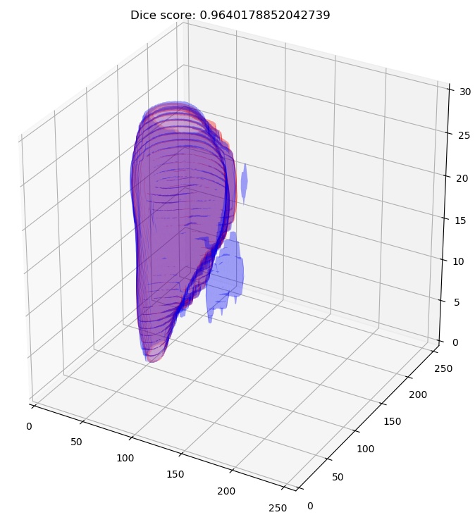
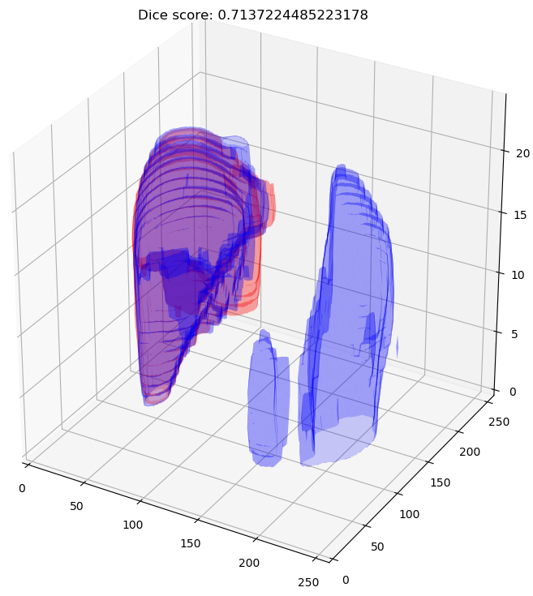
Testing visualization - Unet_v2
Red: Ground truth
Blue: Prediction
Best case
(ITRI_PreRFACT_0037)
Worst case
(ITRI_PreRFACT_0137)

Slide 13
Where I can find the testing visualization?
All testing visualization can be found in folders
Inference_unet_v1 & Inference_unet_v2
File naming rule: dice score_cases name

